Slide 1
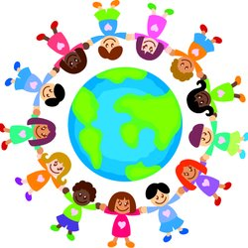
THE WORLD AROUND US

Slide 2
ANIMAL
WORLD

Slide 3
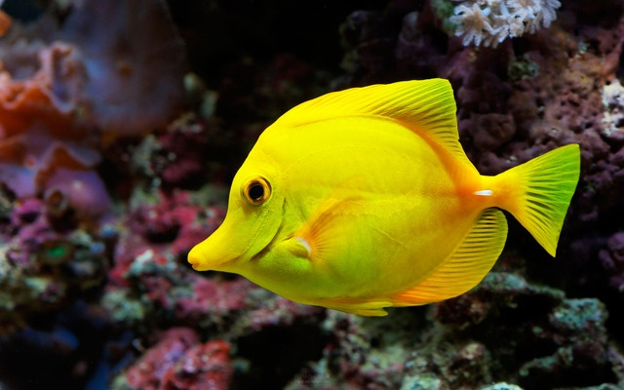

Slide 4
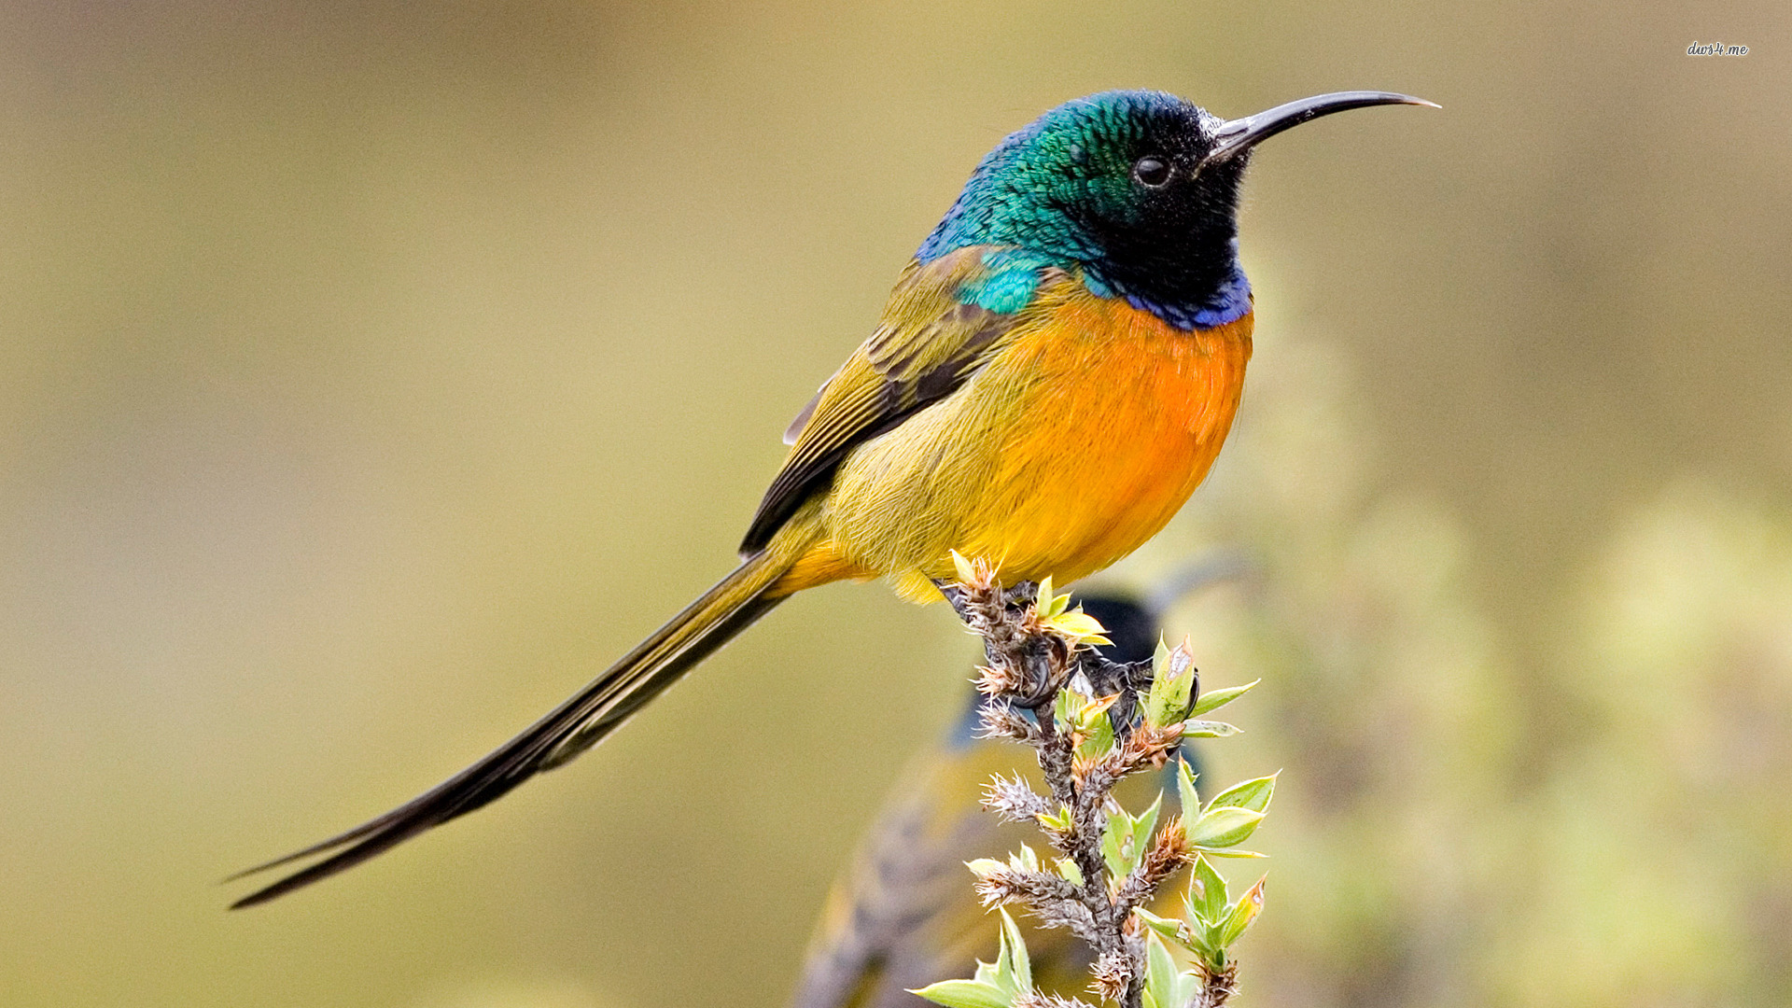

Slide 5
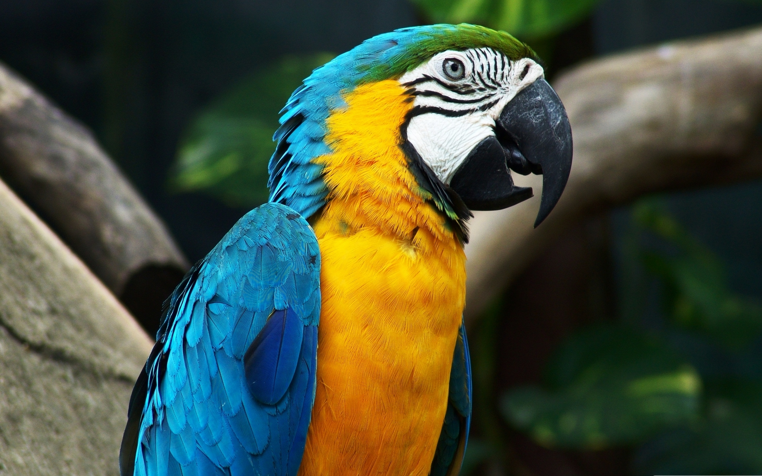

Slide 6
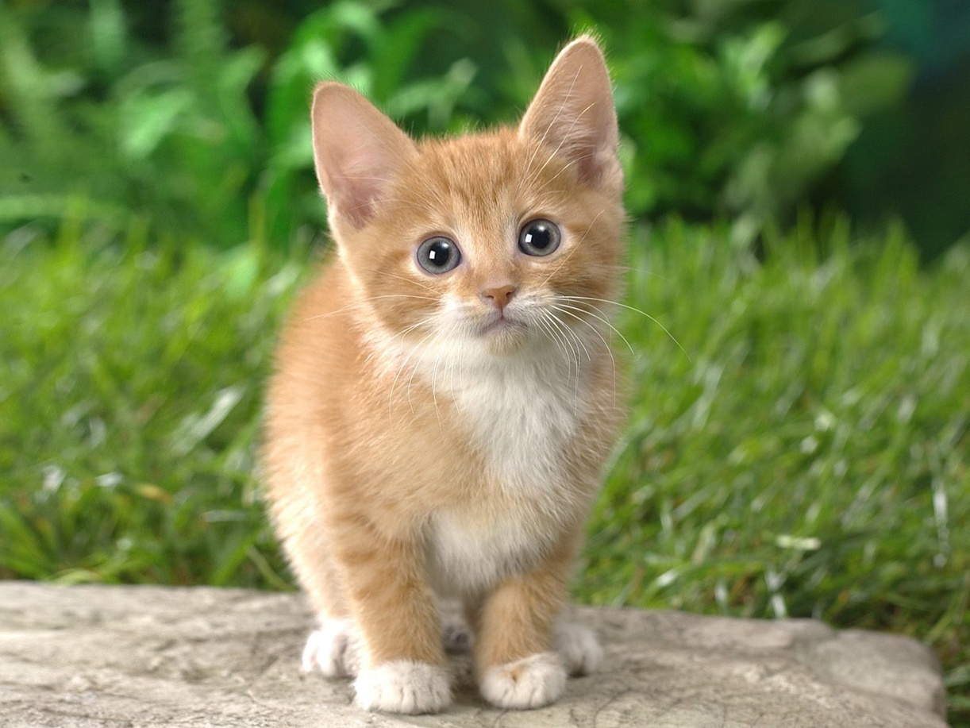

Slide 7
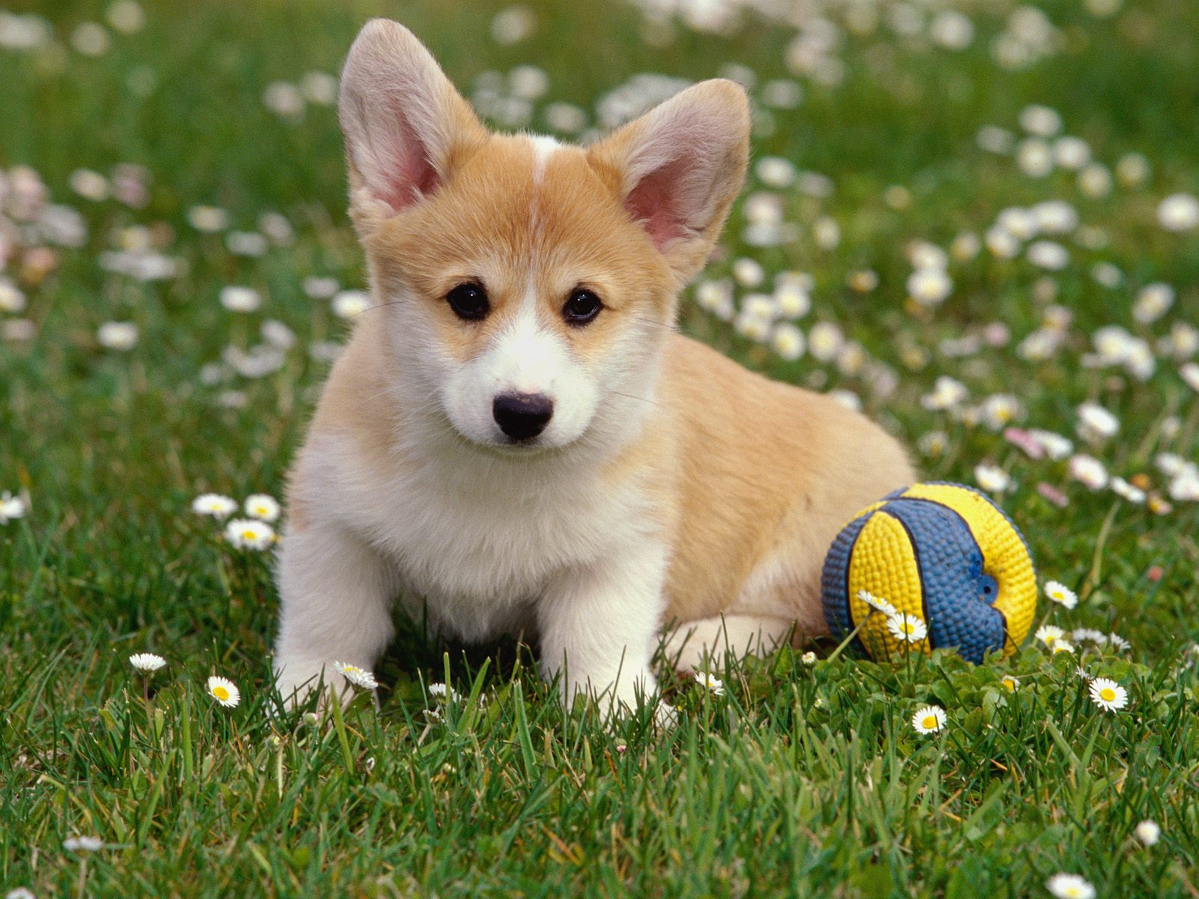

Slide 8
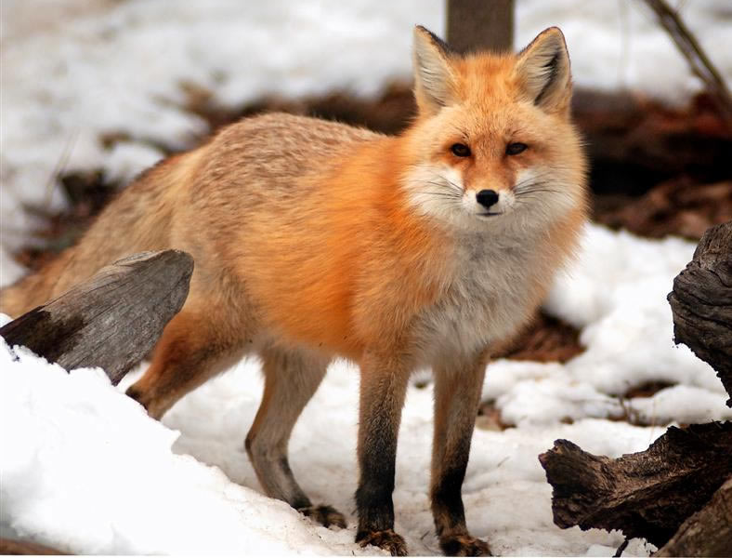

Slide 9
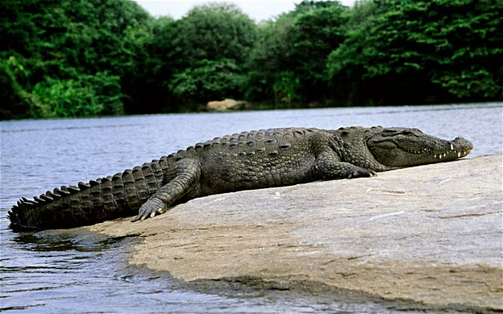

Slide 10
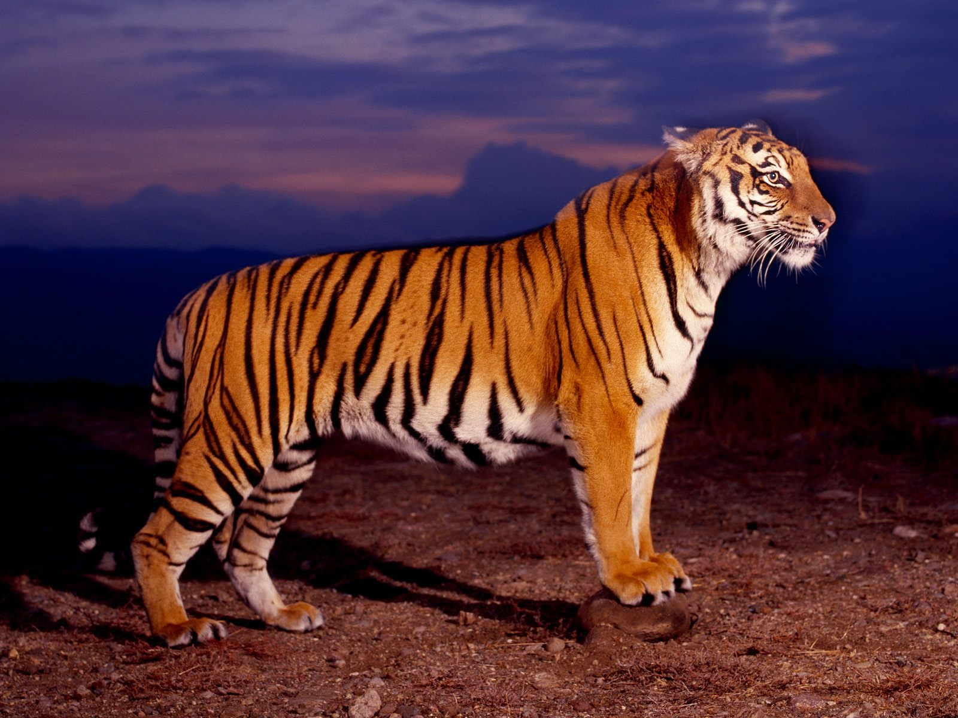

Slide 11
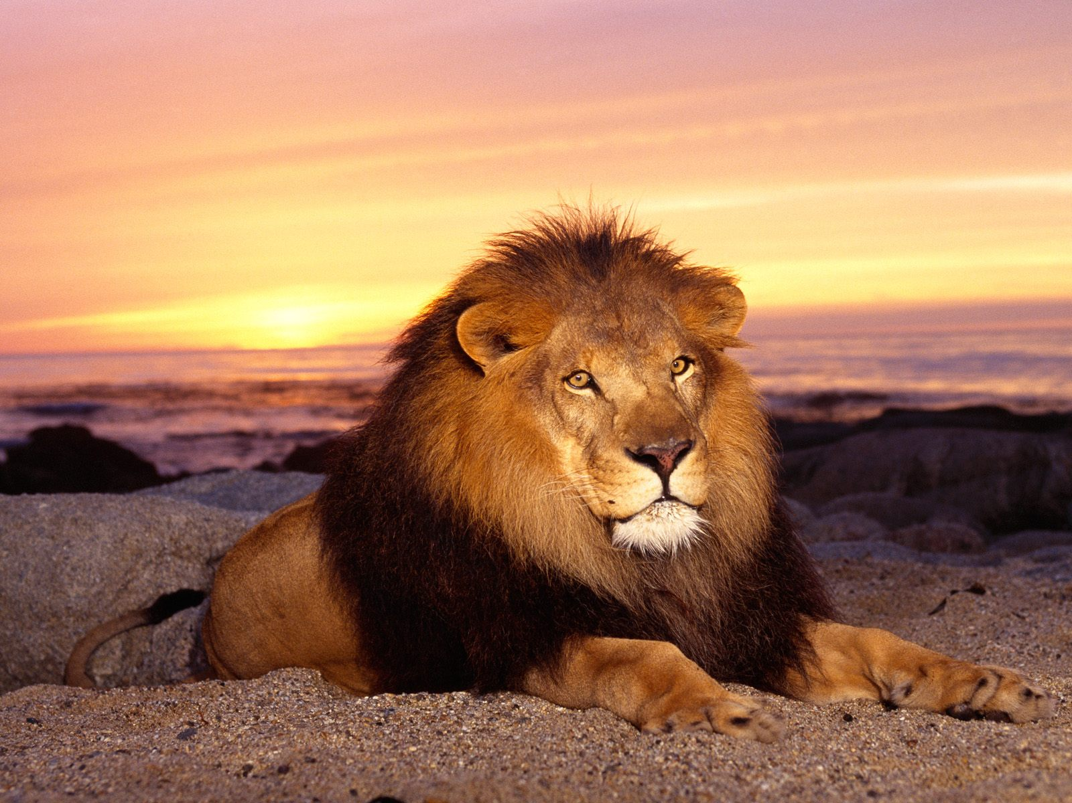

Slide 12
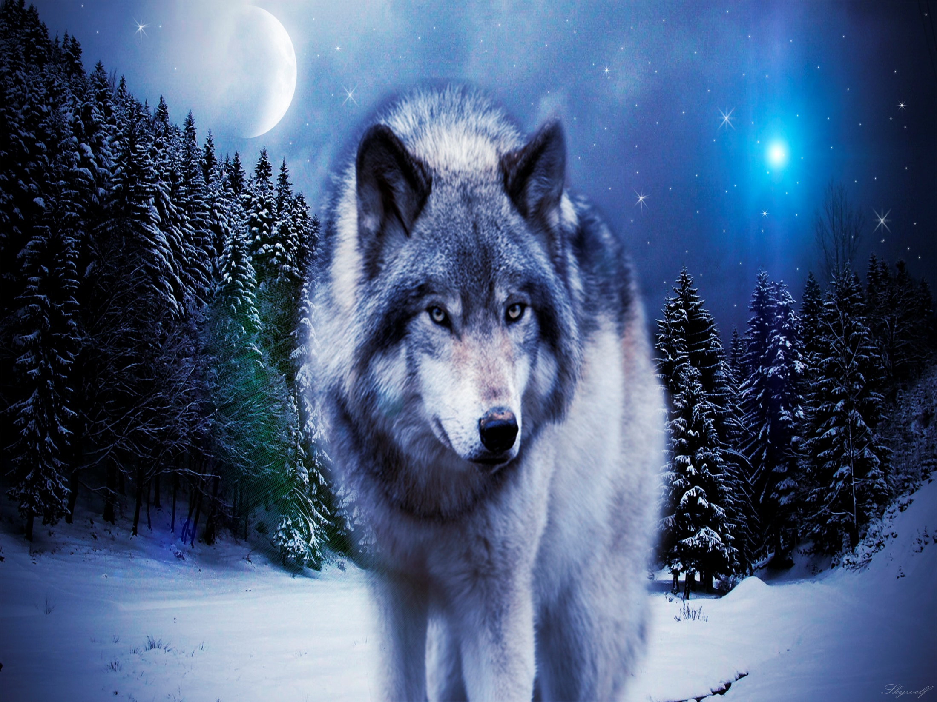

Slide 13
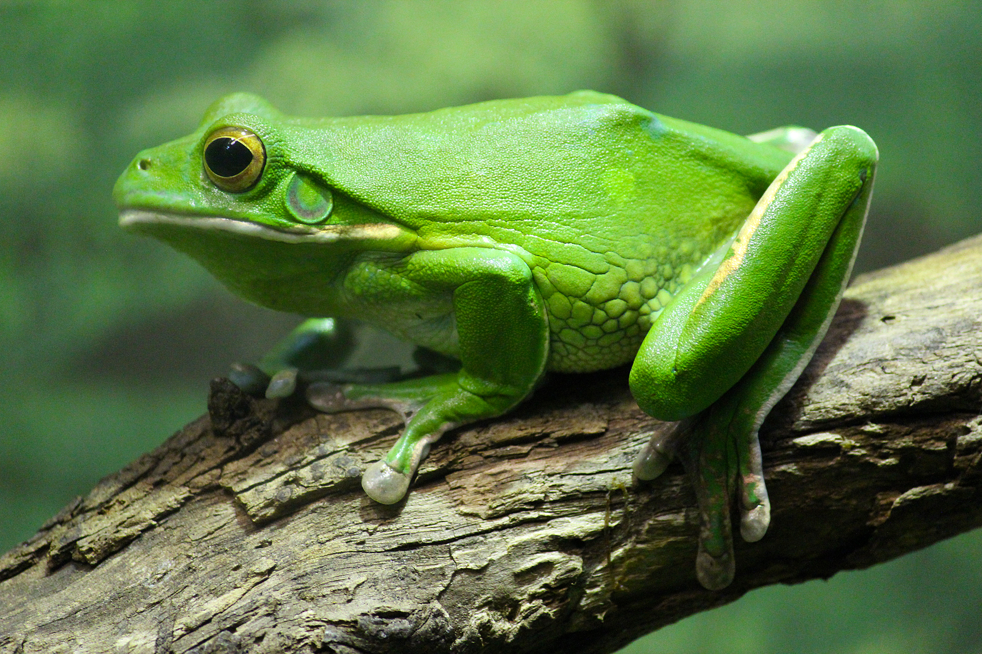

Slide 14
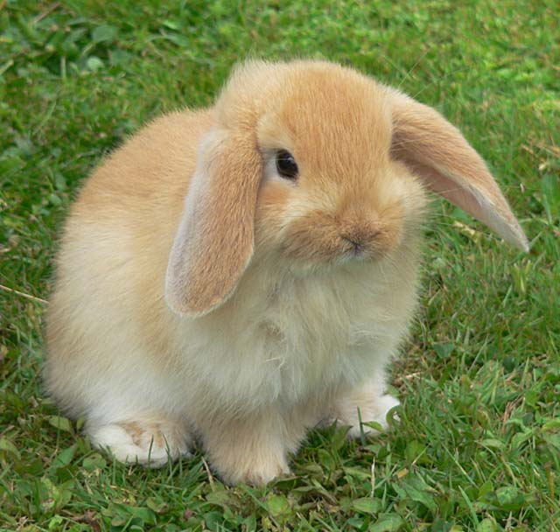

Slide 15
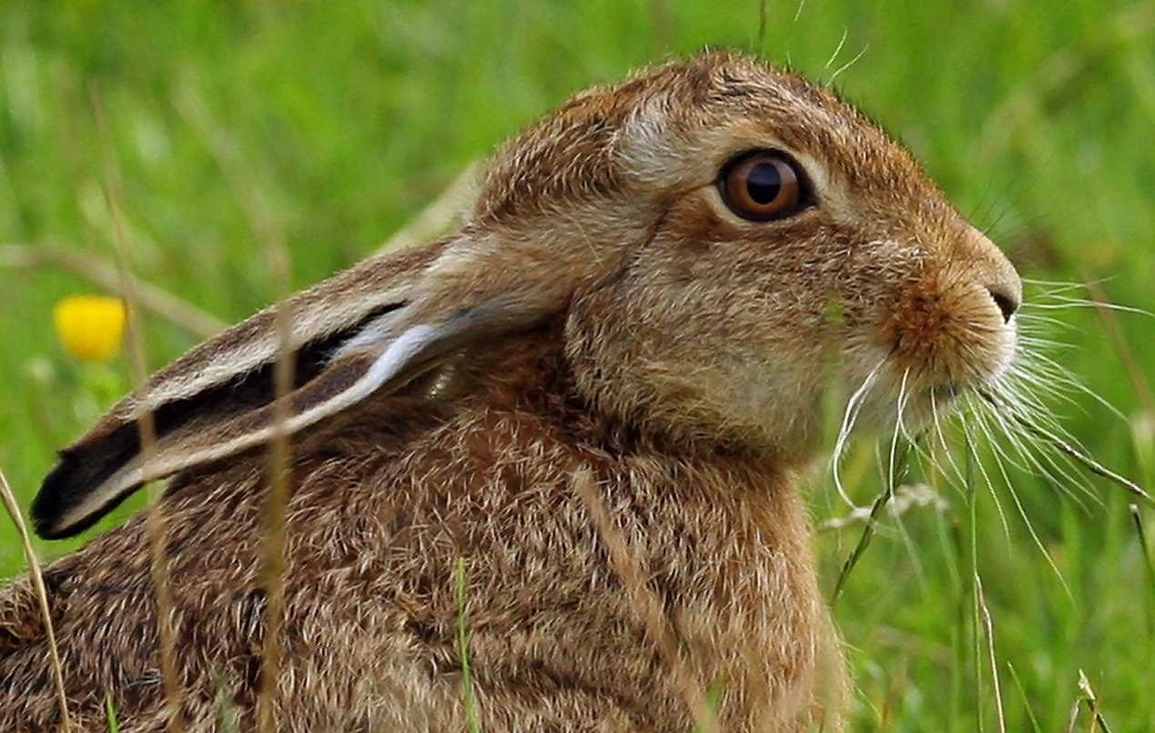

Slide 16
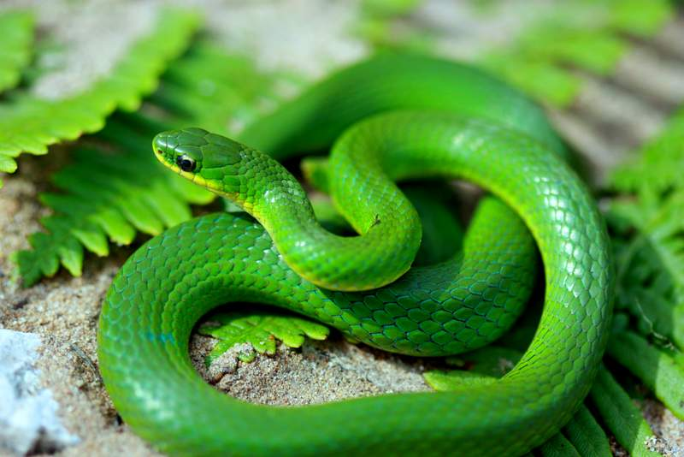

Slide 17
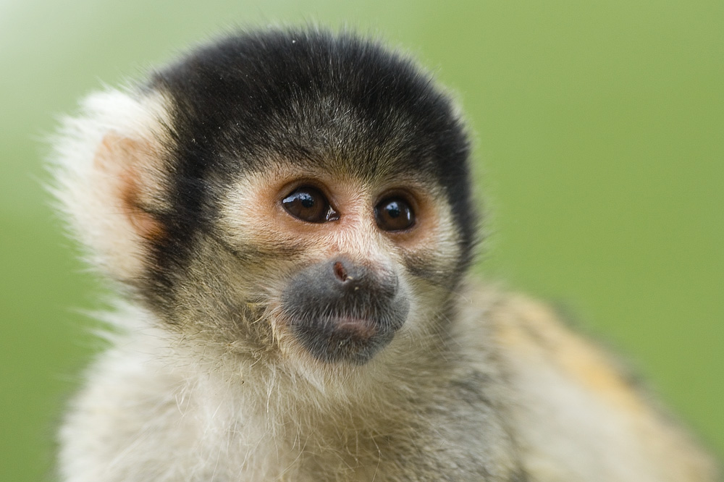

Slide 18
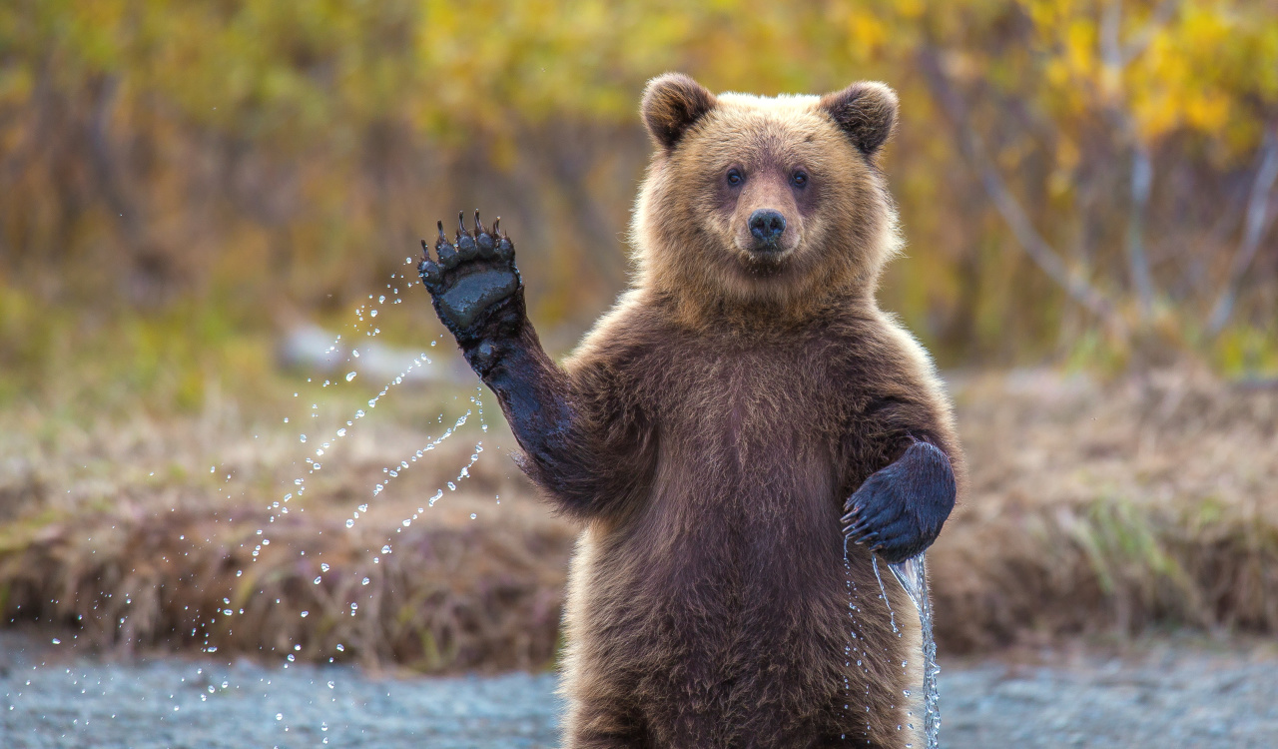

Slide 19
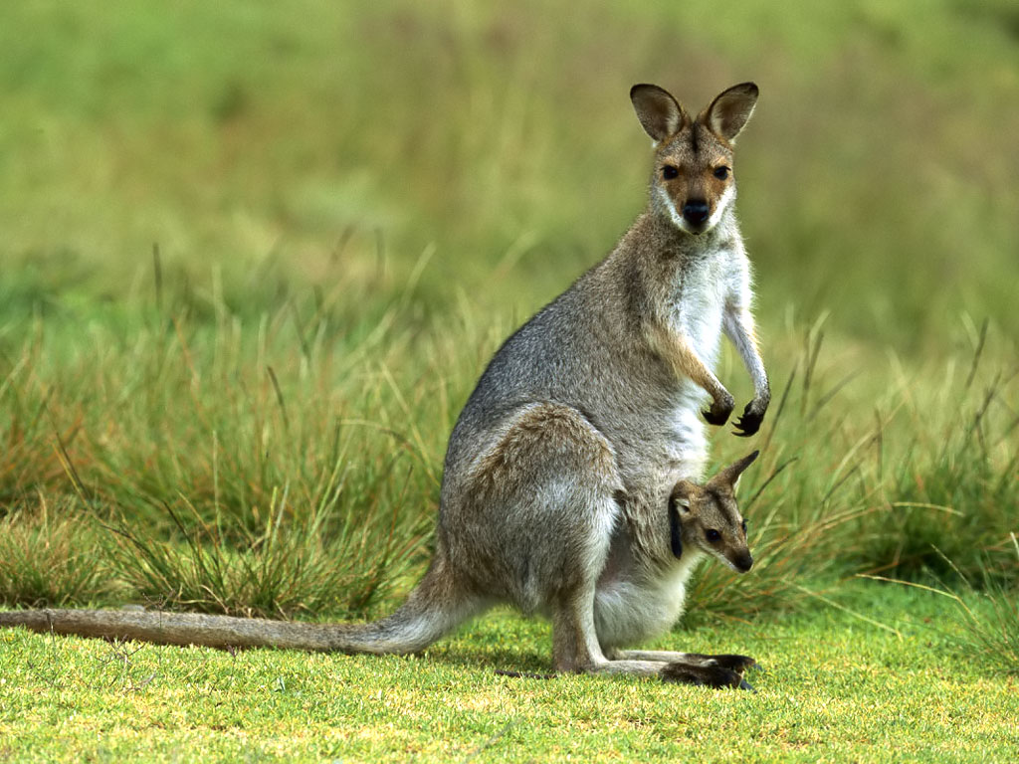

Slide 20
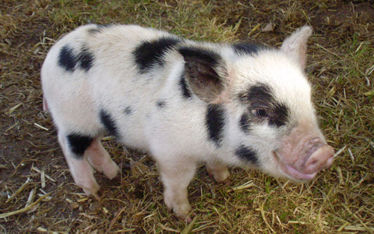

Slide 21
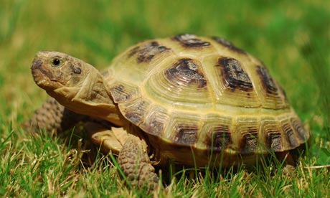

Slide 22
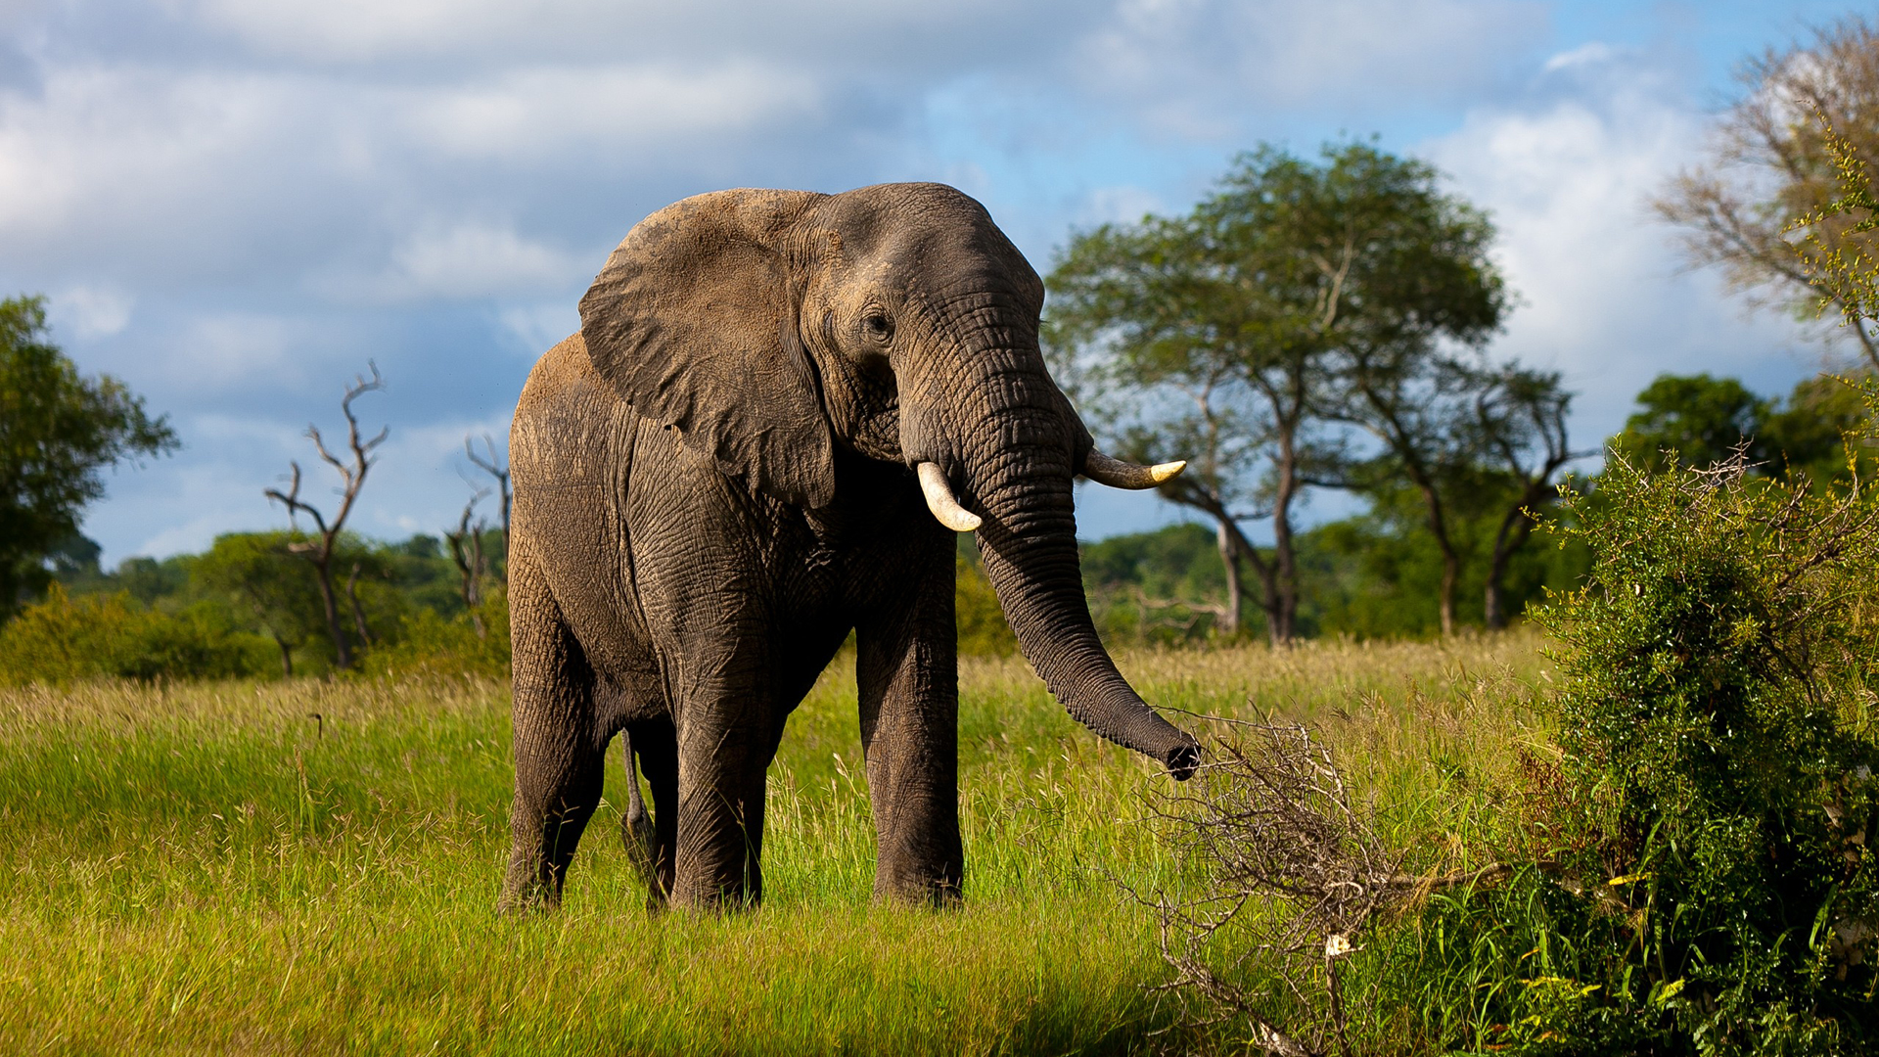

Slide 23
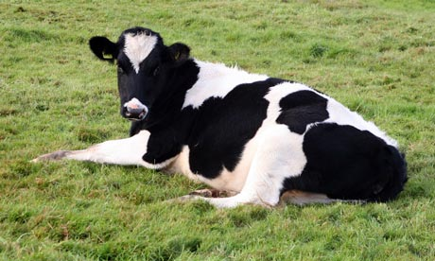

Slide 24
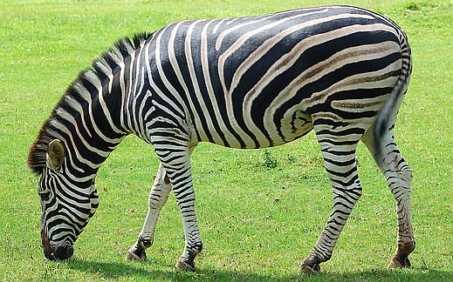

Slide 25
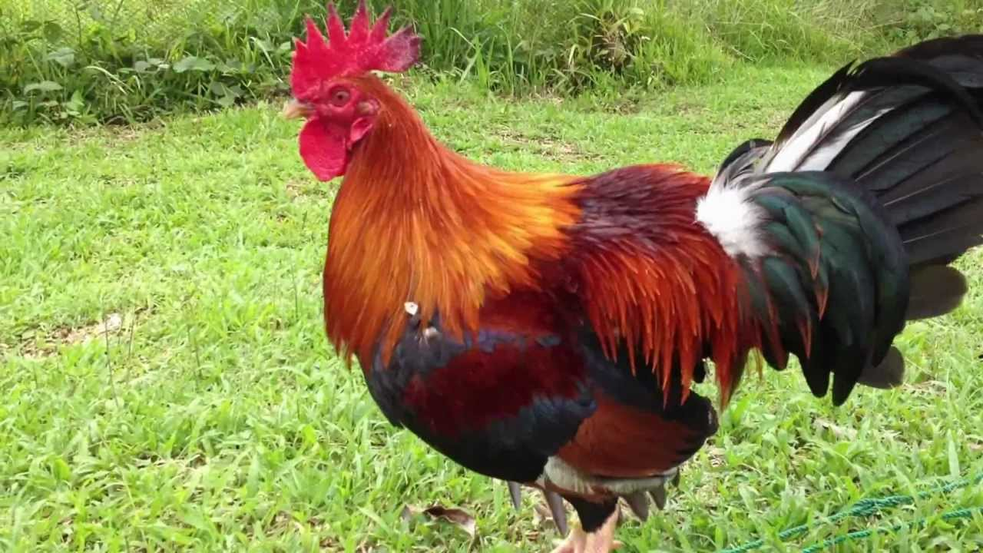

Slide 26
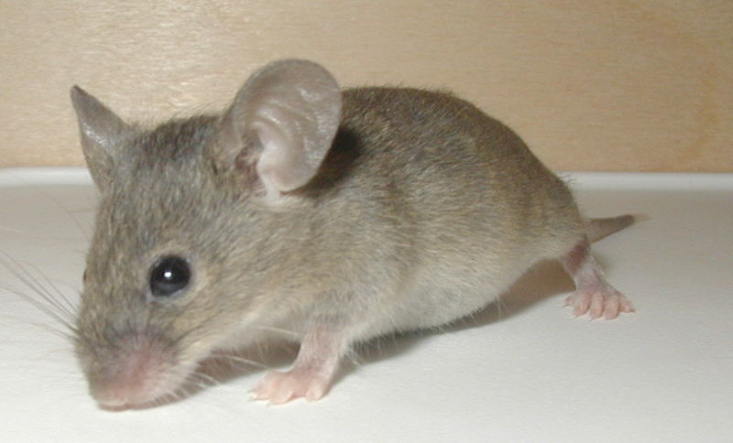

Slide 27
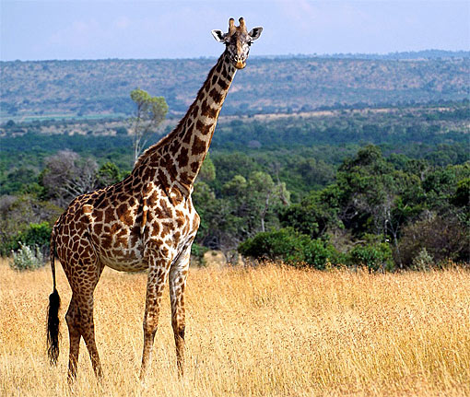

Slide 28
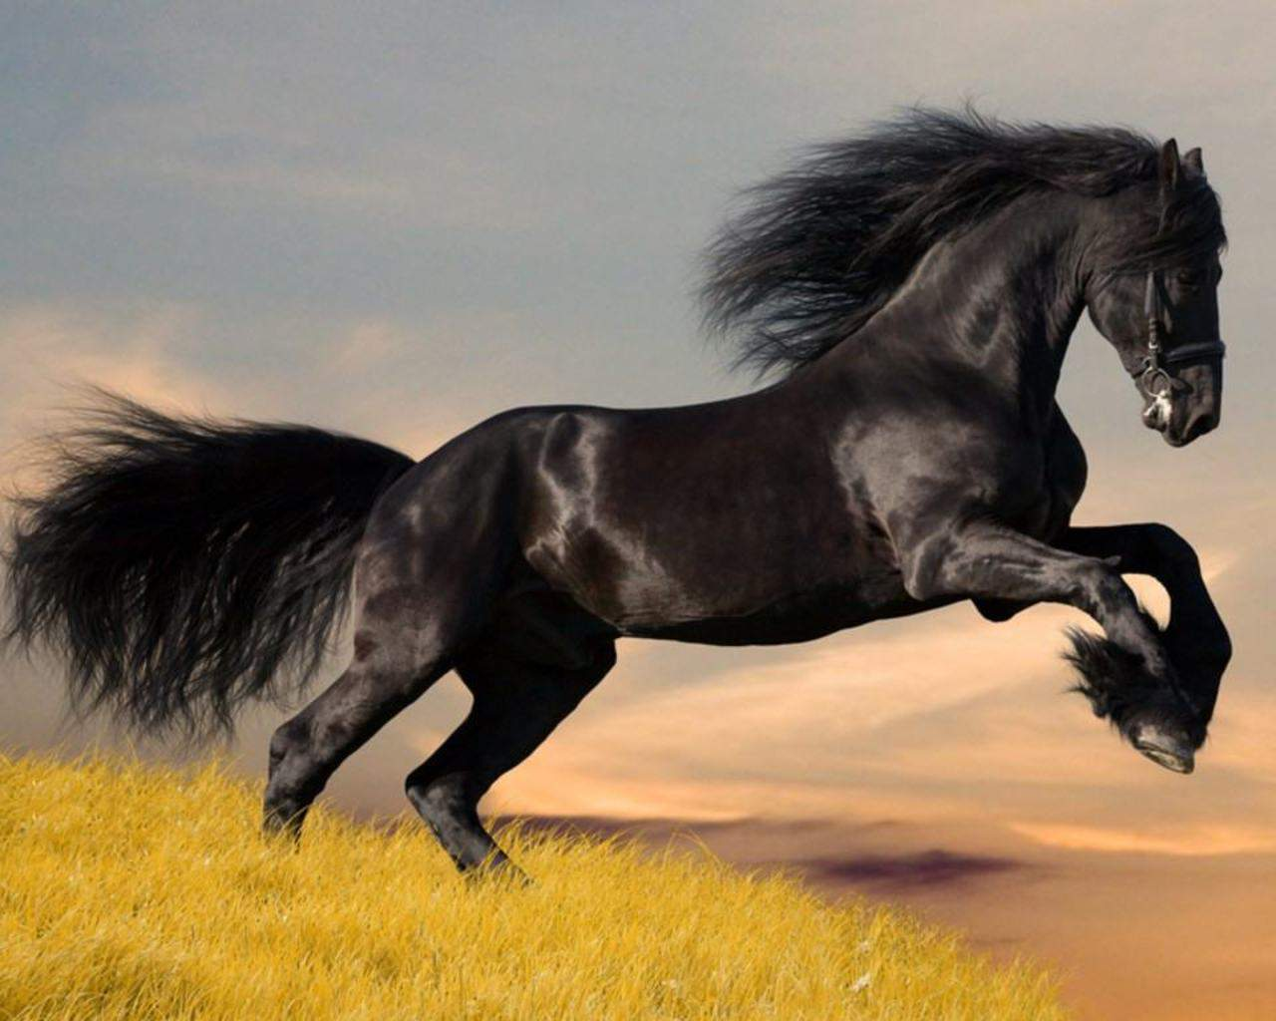

Slide 29
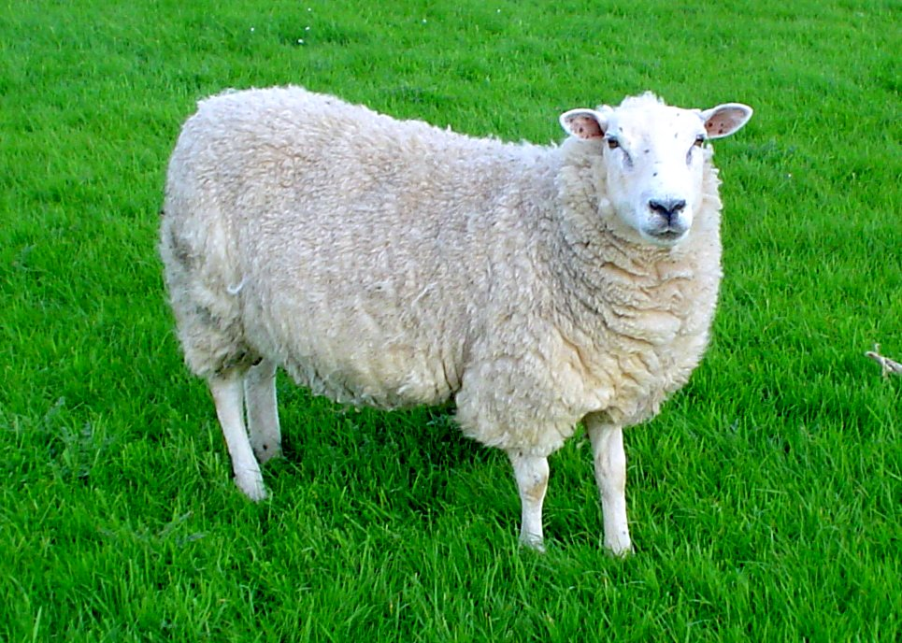

Slide 30
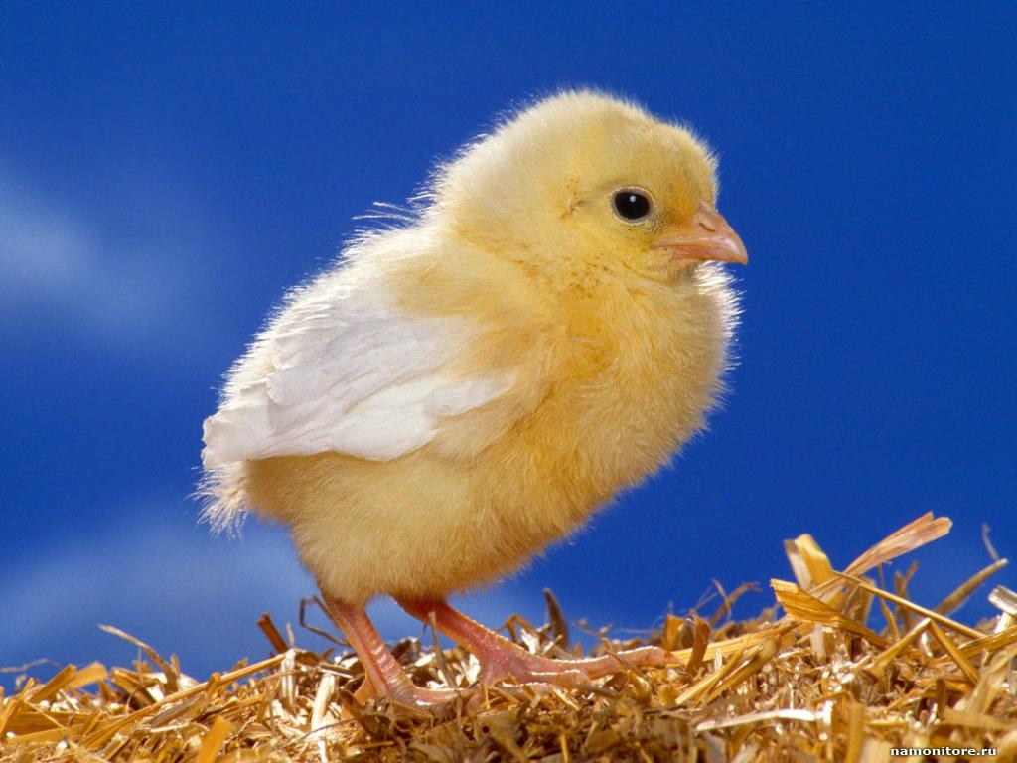

Slide 31
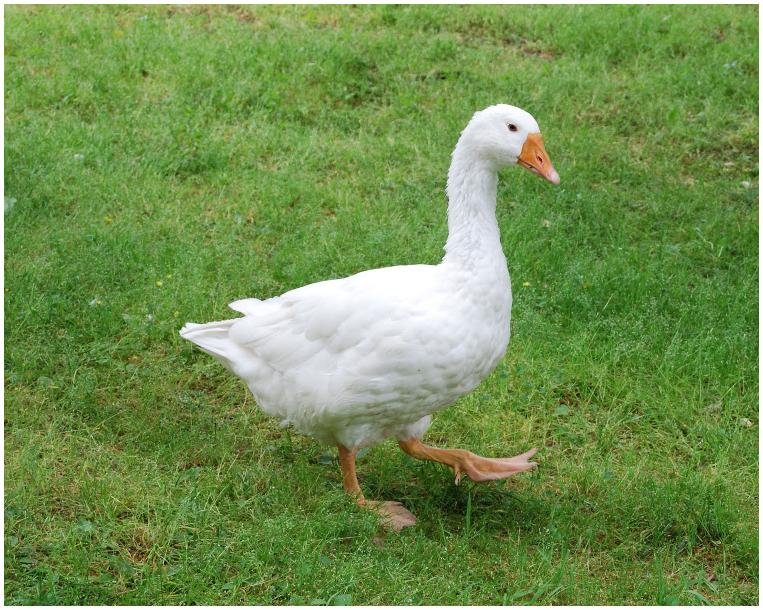

Slide 32
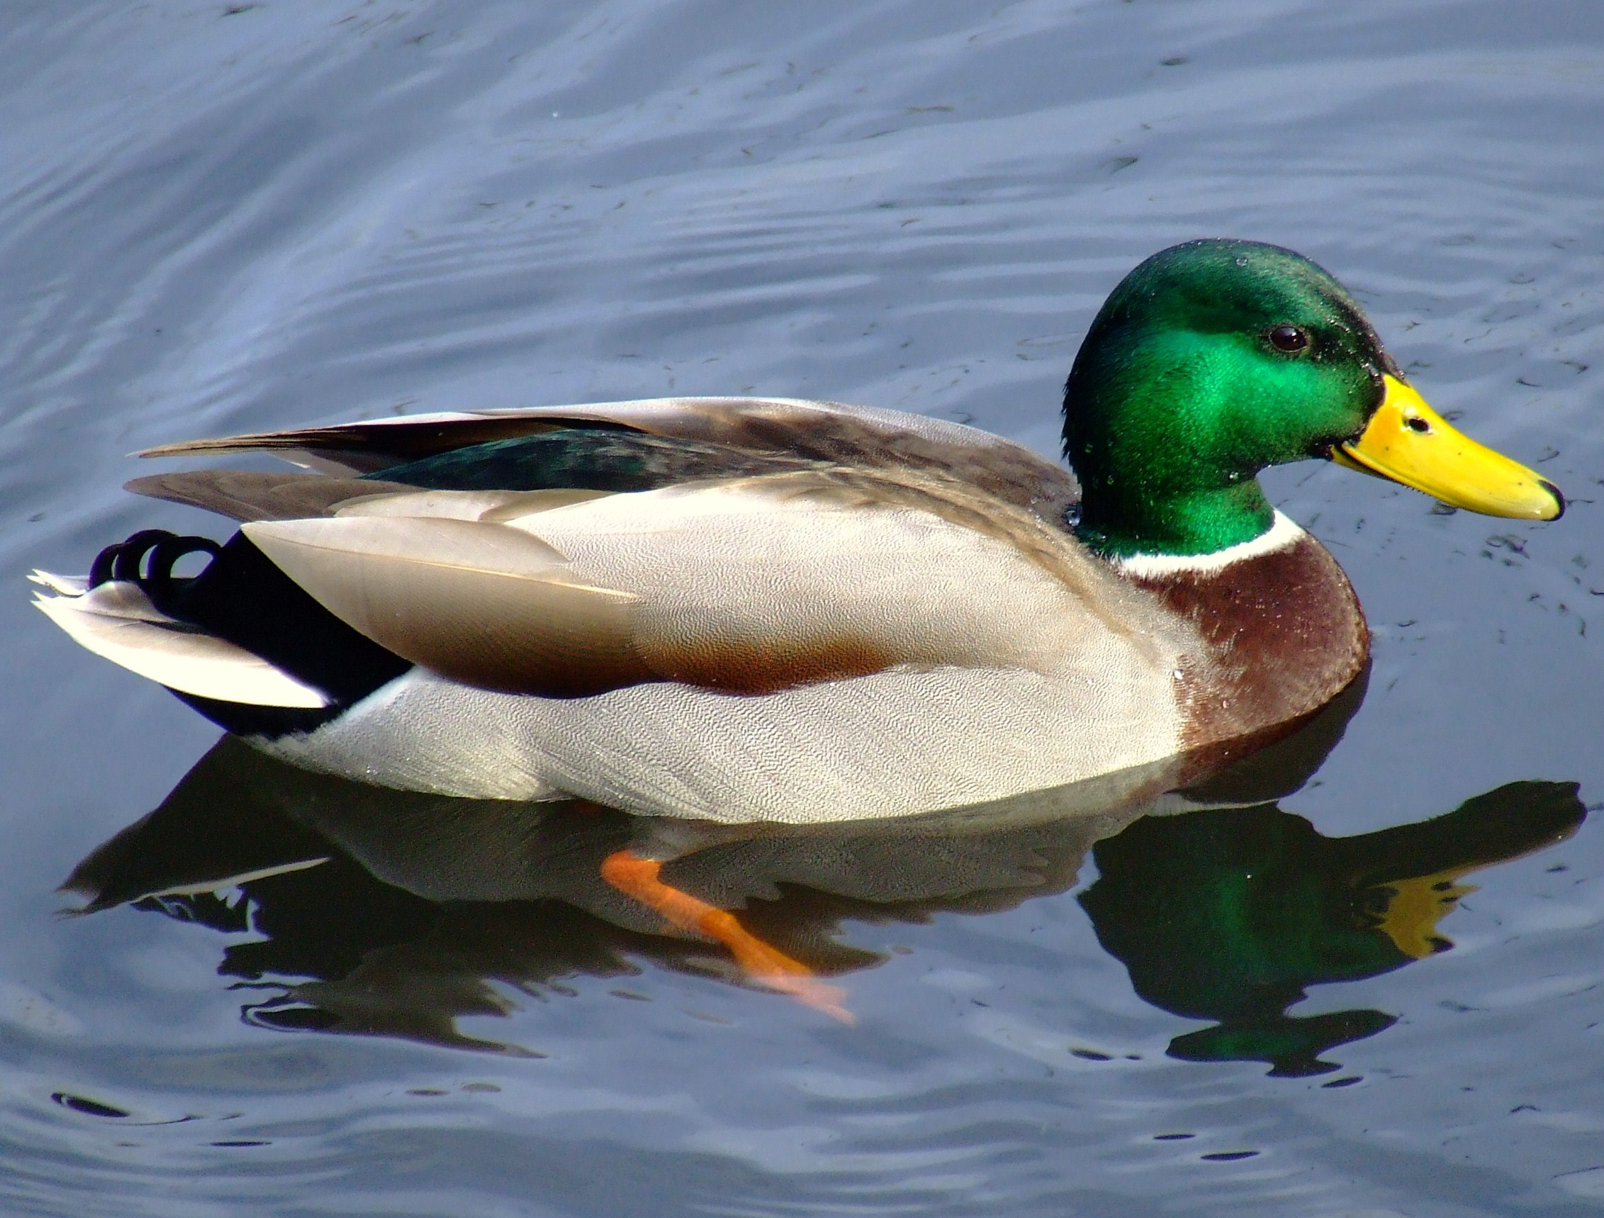

Slide 33
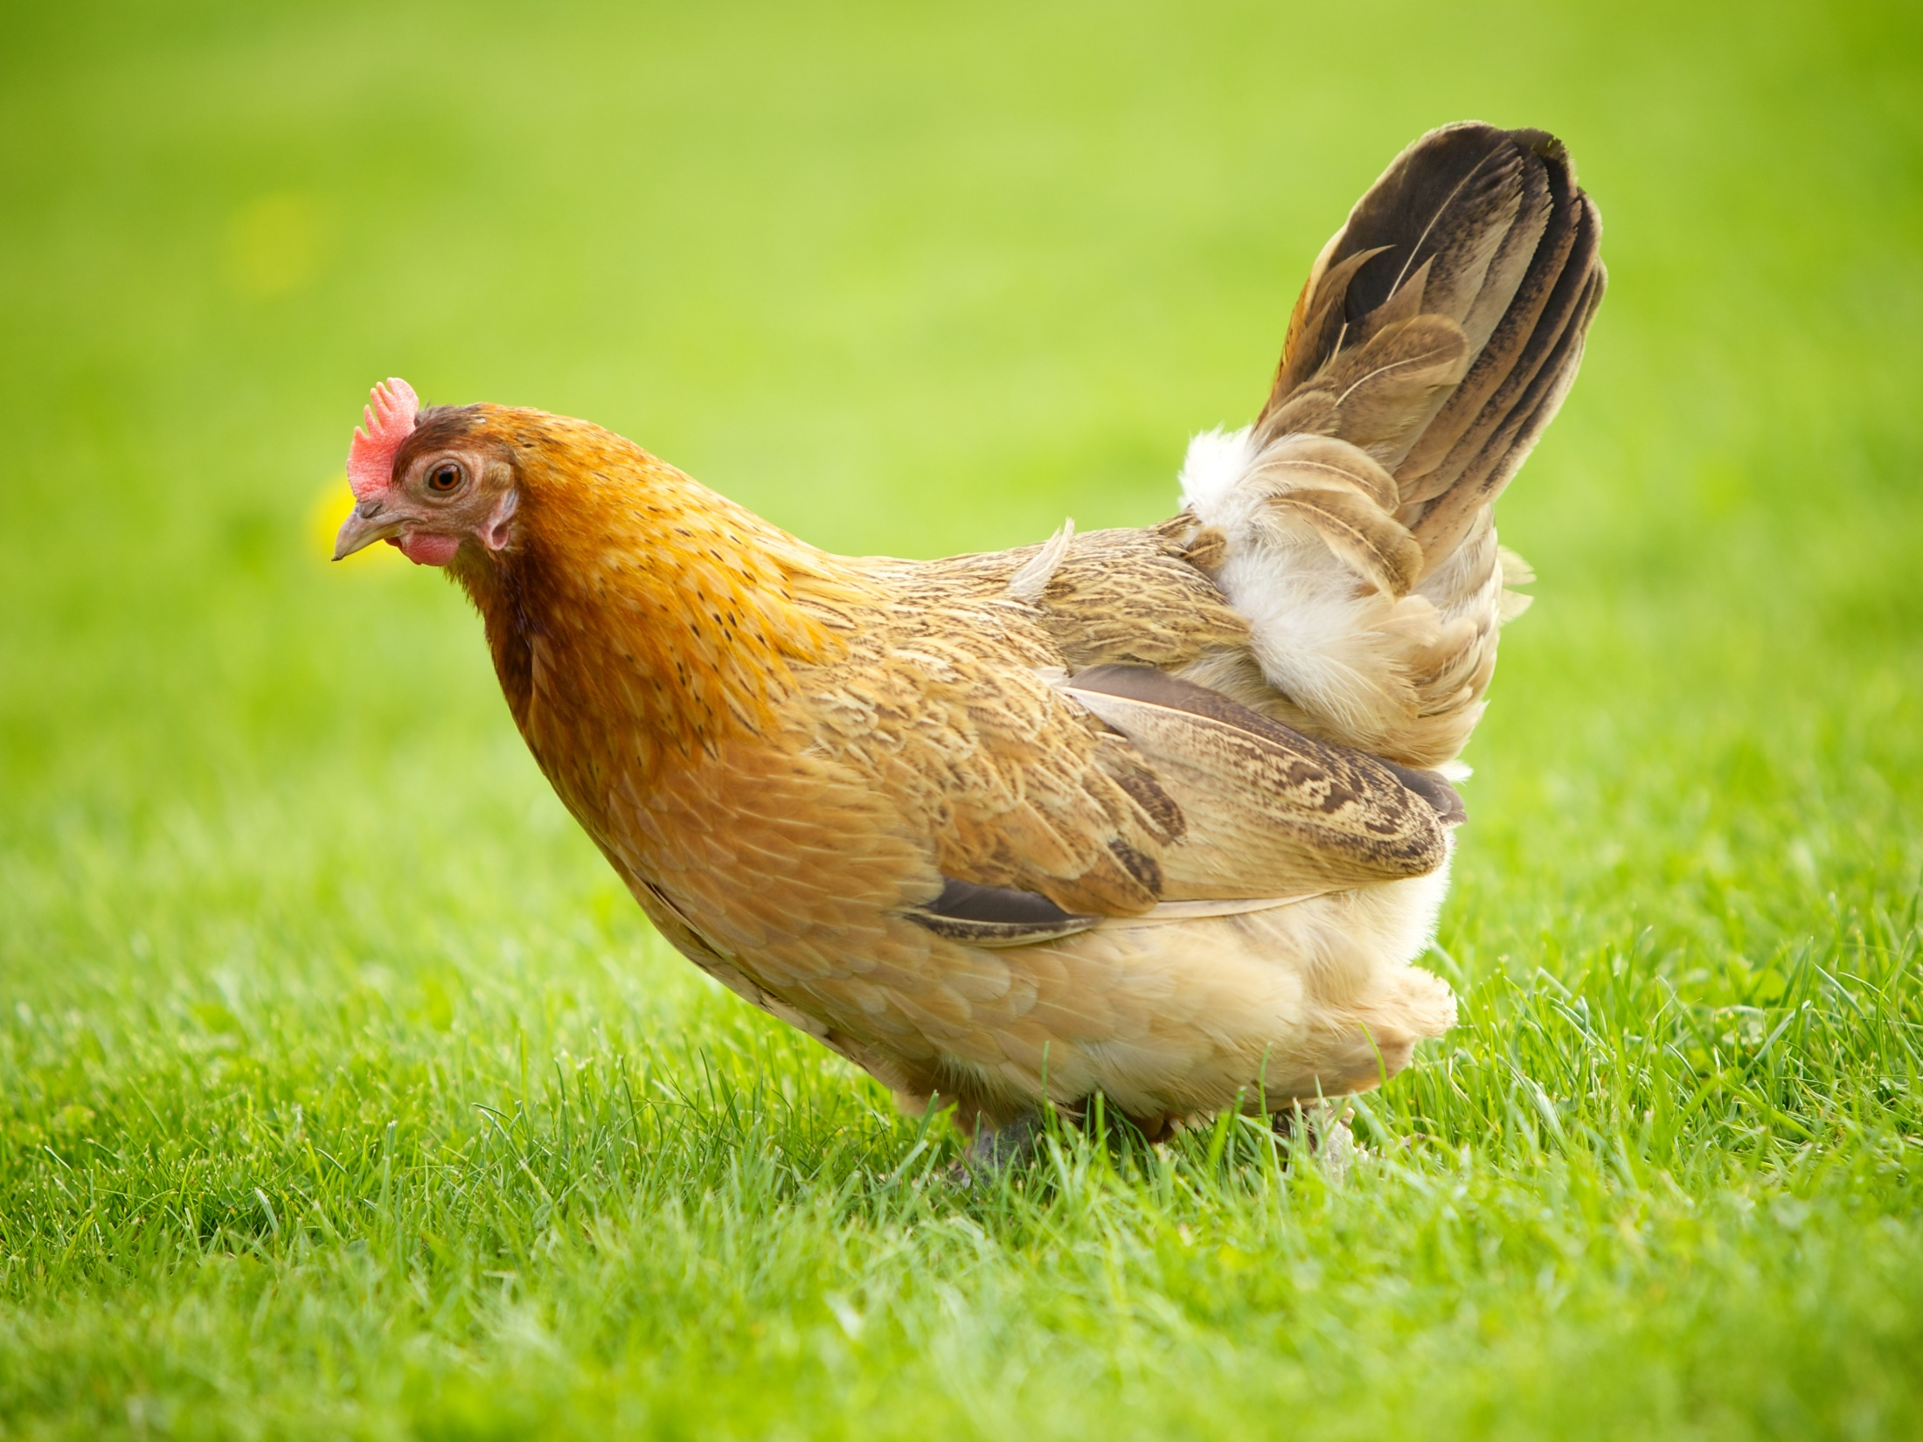

Slide 34
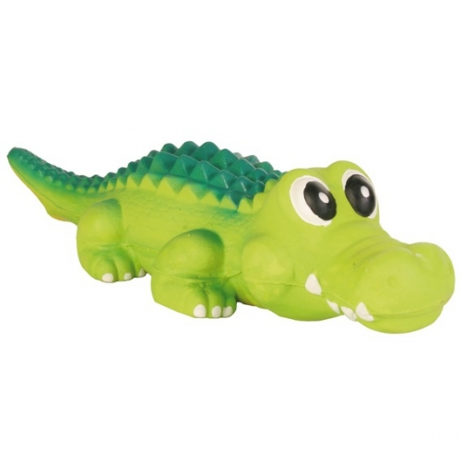
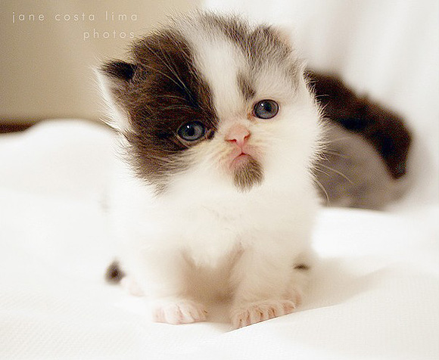
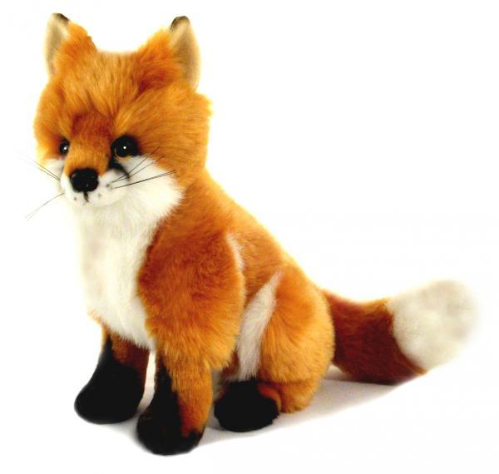
It can swim. It is green. It is long.
2) It is a domestic animal. It can run and jump. It likes milk very much.
3) It is an orange animal. It lives in the forest. It is very cunning.

Slide 35
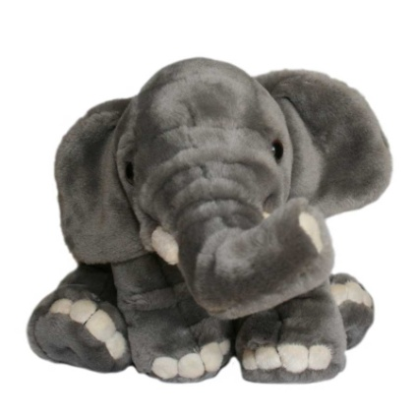
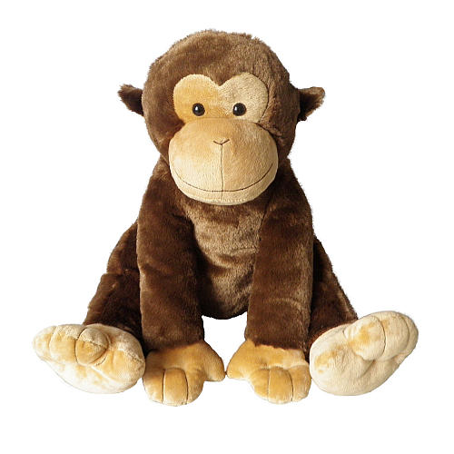
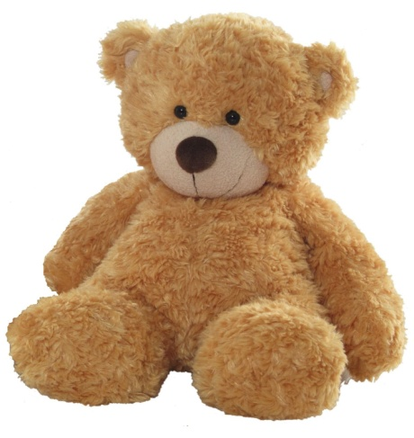
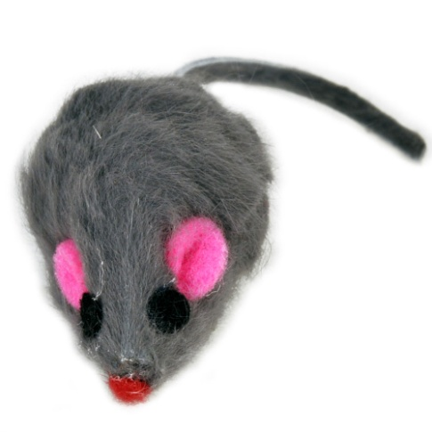
4) It is grey. It has got a long nose. It lives in Africa.
5) It is brown. It can climb in the trees. It likes bananas.
6) It may be brown and white. It likes honey.
7) It is grey. It likes cheese.

Slide 36
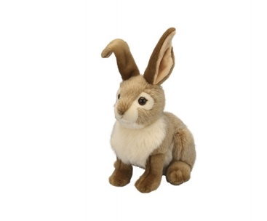
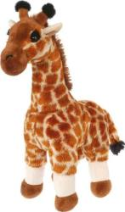
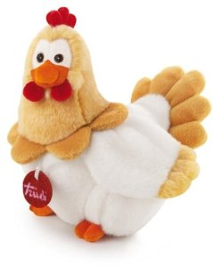
8) It is grey in summer and it is white in winter.
9) It lives in Africa. It is orange and has a long neck.
10) It is a domestic animal. It gives us eggs.

Slide 38
1) Who is grey in this picture? 2) Who can swim in this picture? 3) What colour is the bear in this picture? 4) Who can fly in this picture? 5) What colour is the fox in this picture? 6) What colour is the monkey in this picture? 7) Who is sitting next to the bear and the fox? 8) What other animal is near the lion?

Slide 39
PARTS OF
THE BODY

Slide 40
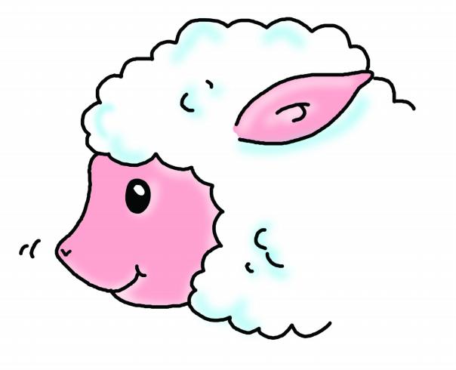
small nose

Slide 41
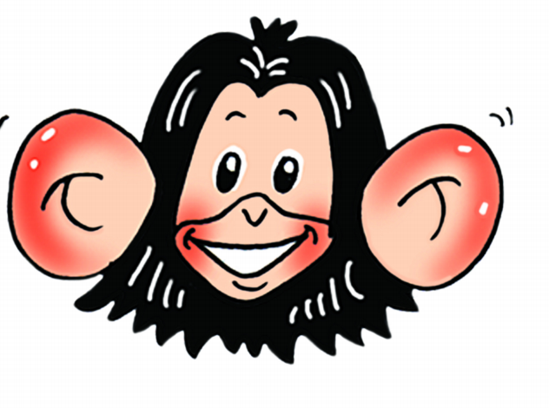
big ears

Slide 42
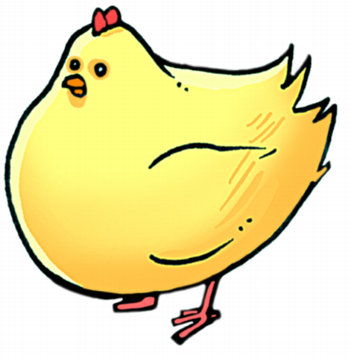
small head

Slide 43
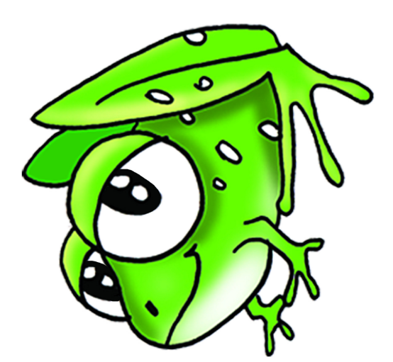
big eyes

Slide 44
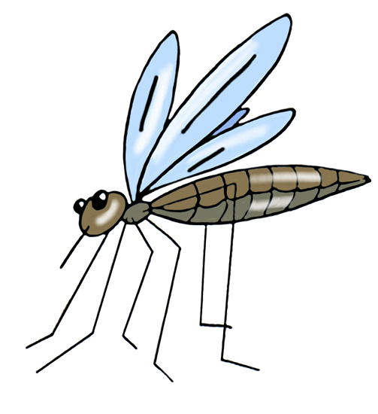
thin legs

Slide 45
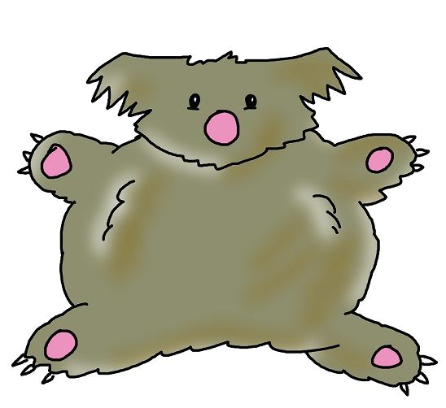
fat body

Slide 46
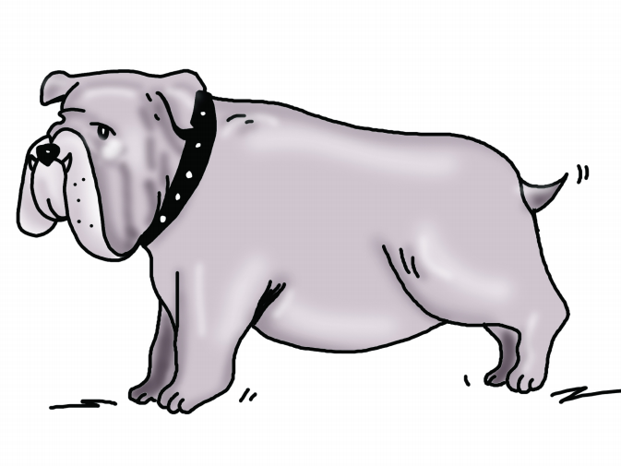
short tail

Slide 47
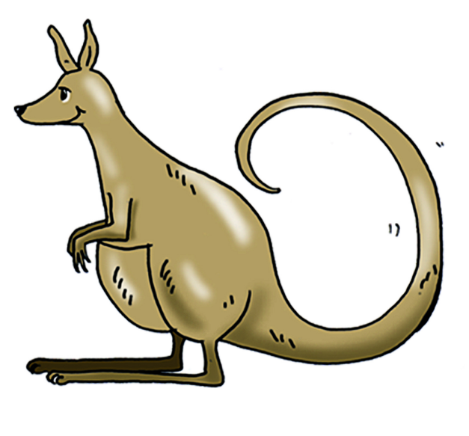
long tail

Slide 48
It is a …
It has got a small/big nose!
It has got big/small ears!
It has got big/small eyes!
It has got long/short legs!
It has got fat/thin body!
It has got long/short tail!

Slide 49
* SEASONS
* MONTHS
* DAYS OF
THE WEEK

Slide 50
Seasons: winter spring summer autumn
Months:
January
February
March
April
May
June
July
August
September
October
November
December
Days of the week:
Monday
Tuesday
Wednesday
Thursday
Friday
Saturday
Sunday

Slide 51
I liked to:
play
sing
watch
run
make exercises
describe pictures

